Slide 1
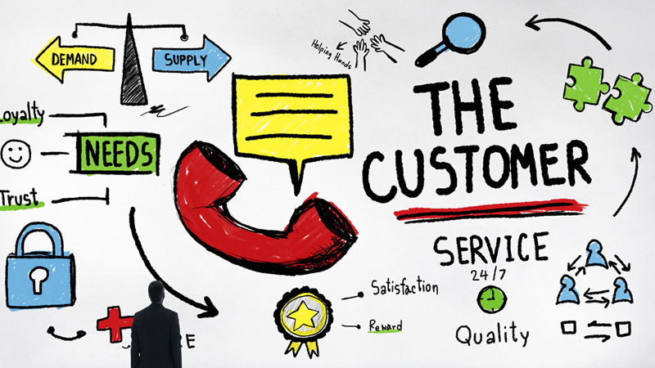
The Service Strategy Lifecycle

Slide 2
Service Strategy Overview
Goal:
To operate and grow successfully in the long term. Service providers must have ability to think in a strategic manner.
Must be grounded upon a fundamental acknowledgement that its customers do not buy products, they buy the satisfaction of particular needs. Therefore, to be successful, the services provided must be perceived by the customer to deliver sufficient value in the form of outcomes that the customer wants to achieve.
It sets out guidance to all IT service providers and their customers, to help them operate and thrive in the long term by building a clear service strategy;

Slide 3
Key Principles and Models
The Four Ps of Strategy
Perspective : The distinctive vision and direction;
Position : The basis on which the provider will compete;
Plan : How the provider will achieve their vision;
Pattern : The fundamental way of doing things – distinctive patterns in decisions and actions over time.

Slide 4
Key Principles and Models
Resources and Capabilities
Resources and Capabilities are assets used to create services and so are known as Service Assets.
Resources are direct inputs for production.
Capabilities represent an organization’s ability to coordinate, control and deploy resources to produce value.
It is relatively easy to acquire resources compared to capabilities.

Slide 5
Main activities
1) Define the Market:
Evaluate the services that you could potentially offer and who you may be able to offer them to.
2) Develop the Offerings:
Continue to formulate services that you think will be worthwhile pursuing.
Utility and Warranty are considered at this stage.
3) Develop Strategic Assets:
Look for opportunities to exploit your services and capabilities
4) Prepare for Execution:
Take all the necessary steps to ensure that we are ready to go ahead and it is worthwhile doing so.

Slide 6
Resources and Capabilities
From a competitive perspective, service providers need to develop specific capabilities to differentiate themselves from competitors.
Capabilities |  | Resources
Management |  | Financial Capital
Organization |  | Infrastructure
Process |  | Applications
Knowleadge |  | Information
People

Slide 7
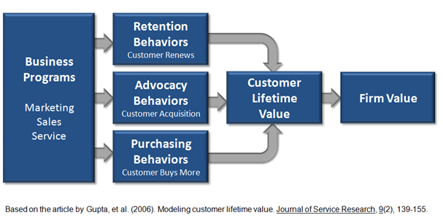
The Value to the customer

Slide 8
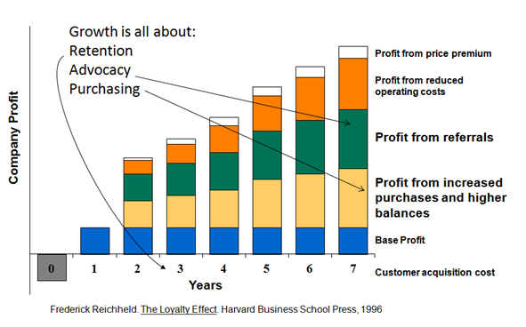
Utility
Is what the customer gets (Fitness For Purpose).
This is communicated through the support of certain results or by preventing certain risks and costs.

Slide 9
Warnity
It is how it is delivered (Fitness For Use).
Warranty of a service is described in terms of:
• Availability : It offers the customers the guarantee that the services are available according to the agreed conditions
• Capacity : Without the effective monitoring of capacity issues, service providers are not in a position to offer the utility of most of the services.
• Continuity : Ensures that the service supports the business even during times of great difficulty or disasters.
• Security : Guarantees to customers that they can make use of the service safely and securely.

Slide 10
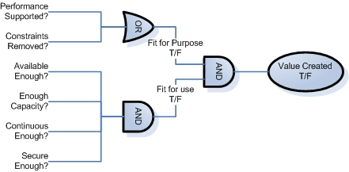
The Value to the customer
Two primary elements: Utility and Warranty

Slide 11
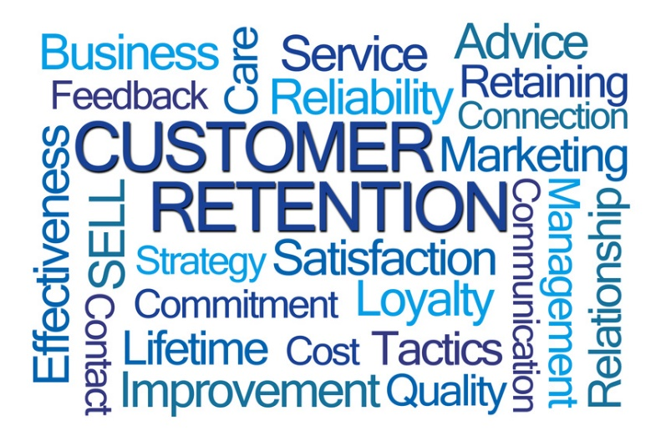
How the value is built?
It has two primary elements: Utility and Warranty
Utility is what the customer gets (Fitness For Purpose). This is communicated through the support of certain results or by preventing certain risks and costs.
Warranty is how it is delivered (Fitness For Use). Warranty of a service is described in terms of:
Availability : It offers the customers the guarantee that the services are available according to the agreed conditions.
Capacity : Without the effective monitoring of capacity issues, service providers are not in a position to offer the utility of most of the services.
Continuity : Ensures that the service supports the business even during times of great difficulty or disasters.
Security : Guarantees to customers that they can make use of the service safely and securely.

Slide 12
Service Provider types
Type I Internal Service Provider
Internal Service provider refers to the business functions within an organization. Administration, finance, human resources, and IT service providers all comes under internal service providers.
Type II Shared Service Provider
In this, business functions such as IT, human resources, and logistics are consolidated into an autonomous special unit called a Shared Service Unit (SSU).
Type III External Service Provider
External service provider refers to the third party service providers. It can offer competitive prices and drive down unit cost by consolidating demand.

Slide 13
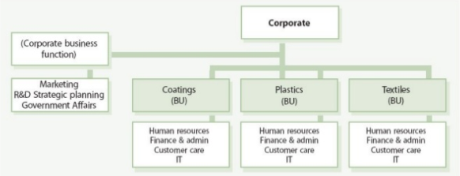
Type I Internal Service Provider

Slide 14
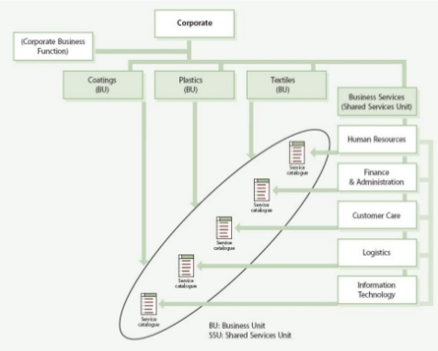
Type II Shared Service Provider

Slide 15
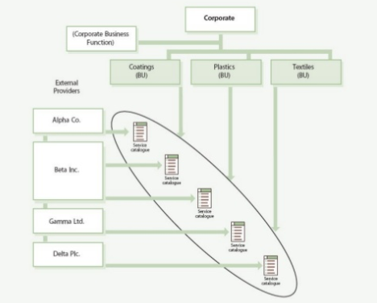
Type III External Service Provider

Slide 16
Service Strategy Key Processes
Financial Management
Service Portfolio Management
Demand Management

Slide 17
Financial Management

Slide 18
Basic Concepts
Responsible for managing an IT service provider’s budgeting, accounting and charging requirements.
It provides the business and IT with the quantification, in financial terms, of the value of IT services, the value of the assets underlying the provisioning of those services, and the qualification of operational forecasting.
Activities do not exist solely within the IT finance and accounting domain. Many parts of the organization interact to generate and use IT financial information.

Slide 19
Financial Basic Concepts
Service Valuation
Cost of providing the Service
Value to the customers receiving the Service
Service investment Analysis
Understand the total lifecycle value and cost of proposed new services or projects
Accounting
Keeping track of what has been spent, assigned to appropriate categories

Slide 20

Business Case
It is a decision and planning tool that projects the likely consequences of a business action.
Tool:
http://business-case-builder.com/
Advisors:
https://www2a.cdc.gov/cdcup/library/practices_guides/CDC_UP_Business_Case_Practices_Guide.pdf

Slide 21
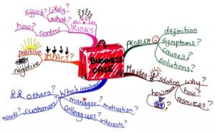
Business Impact Analysis (BIA)
A BIA seeks to identify a company’s most critical business services through analysis of outage severity translated into a financial value, coupled with operational risk.
The cost of service outage is a financial value placed on a specific service, and is meant to reflect the value of lost productivity and revenue over a specific period of time.

Slide 22
Service Portfolio Management

Slide 23
Basic Concepts
Goal
To develop a dynamic method for governing investments in service management across the enterprise and managing them for value.
Concepts
Define all existing and proposed services.
Analyze the business needs and the services required.
Approve the changes to the services (retire, renew, replace, retain)
Charter the new services for implementation.

Slide 24
Main Roles
Product Manager (PM)
- Own and Manage a set of related services;
- Evaluate market opportunities and customer needs;
- Create new business cases;
Plan new service development programs.
Business Relationship Manager (BRM)
- Identify and document customer needs.

Slide 25
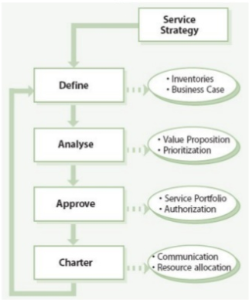
Main Activities

Slide 26
Demand Management

Slide 27
Basic Concepts
Understand customer requirements for service and how these vary over the business cycle.
- Ensure the provision of appropriate levels of service
By varying provision or by influencing customer demand.
- Ensure Utility and Warranty we offer matches the customer needs.

Slide 28
Key Concepts
Types | Description
Core Service | An IT service that deliver outcomes desired by one or more customers.
Supporting Service | A service that enables or enhances a core Service.
Pattern of Business Activity (PBA) | Workload profile of one or more business activities Varies with time. Represents changing business demands

Slide 29
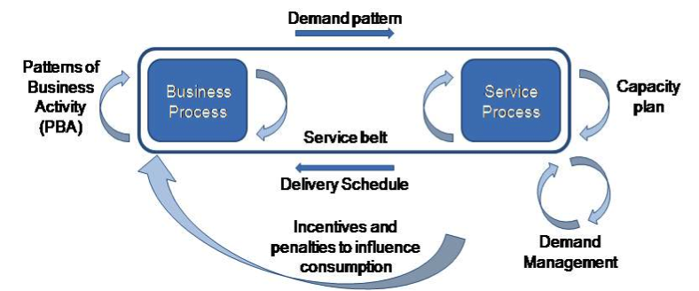
Activity based Demand Management

Slide 30
Key Concepts
Types | Description
User Profile (UP) | Pattern of user demand for IT Services Each user profile includes one or more PBAs.

Slide 31
Key Concepts
Types | Description
Core Service Package | A detailed description of a core service that may be shared by one or more SLPs
Service Package | Detailed description of an IT service that can be delivered to a customer It consists of Service Level Package (SLP)/SLP’s and one or more core and supporting services
Service Level Package (SLP) | Defined level of utility and warranty for a particular service package Each SLP is designed to meet the needs of a particular PBA They are associated with a set of service levels, pricing policy and a Core Service Package
SLP ITIL v3 – SLR ITIL v2

Slide 32
Demand Management Roles
Business Relationship Manager (BRM)
Deep understanding of Customer Demands
Thru PBAs and User Profiles;
Identify correct SLPs for their customers;
Identify unmet customer need;
Negotiate with Product Managers for creation of new services

Slide 33
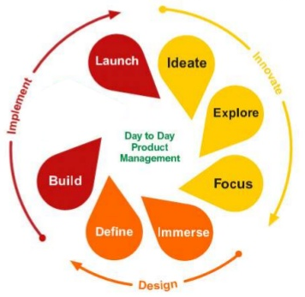
Demand Management Roles
Product Manager (PM)
Consulted by BRM
Deep Knowleadge about Internal Resources

Slide 35
References
2009 Hewlett-Packard Development Company, L.P. The information contained herein is subject to change without notice Service Strategy
https://www.slideshare.net/sagaroceanic11/3-service-strategy
ITIL – Service Strategy and Service Operation
https://burcincelik.wordpress.com/2016/04/08/35/

